Slide 1

Local Database and Shopping Cart
Emerging Technology : Flutter
Week 13
Program Studi Teknik Informatika
Fakultas Teknik – Universitas Surabaya

Slide 2

LOCAL DATABASE
01

Slide 3

Local Database
Sometimes, we need to store data locally. Such data may have quite complex structure, so shared preferences might not suffice, but it’s overkill to store them at the server.
Examples: data that should persist even without Internet connection: shopping cart, games, news articles that have been downloaded/synchronized (when the app connects to the Internet) to read whenever, etc.
For this kind of data, we usually use local database. A popular one is SQLite

Slide 4
Scenario
Let’s continue our movie app by adding shopping cart to buy popular movies digitally as physical DVD (for collection purposes).
We will simply store movie_id, title (so our app doesn’t need to connect to the server database), and quantity.
We will add a Buy button on pop movie list and movie detail

Slide 5
Plugin
One popular plugin to use SQLite with Flutter is sqflite.
https://pub.dev/packages/sqflite
Add this to pubspec.yaml:
sqflite: ^2.4.2
On any page that will use it:
import 'package:sqflite/sqflite.dart';

Slide 6
Database helper
Often times, to perform database operations, we create a separate file commonly referred to as database helper. Let’s create such a helper named class/cart.dart. Prepare the imports and the class itself:
class DatabaseHelper {
static const _databaseName = "cart.db";
static const _databaseVersion = 1;
DatabaseHelper._privateConstructor();
static final DatabaseHelper instance = DatabaseHelper._privateConstructor();
static Database? _database;
// functions here
}

Slide 7
Database helper (2)
Initialize the database and prepare for reading. If the database does not exist, it will be created along with the tables
import 'package:path/path.dart';
Future _onCreate(Database db, int version) async {
await db.execute('''
CREATE TABLE cart (
id INTEGER PRIMARY KEY AUTOINCREMENT,
movie_id INTEGER NOT NULL,
title TEXT NOT NULL,
jumlah TEXT NOT NULL
)
''');
}
----------------------------------------------
Future<Database?> get database async {
if (_database != null) return _database;
_database = await _initDatabase();
return _database;
}
_initDatabase() async {
String path = join(await getDatabasesPath(),
_databaseName);
return await openDatabase(path,
version: _databaseVersion, onCreate:
_onCreate);
}

Slide 8
Database helper (3)
Next, we prepare functions for CRUD. We will need functions to insert and view all data. Insert is used when user adds a movie to the cart. View all data is used on a new page to see the cart contents
Future<int?> addCart(Map<String, dynamic> row) async {
Database? db = await instance.database;
return await db!.insert('cart', row);
}
Future<List<Map<String, dynamic>>?> viewCart() async {
Database? db = await instance.database;
return await db!.query('cart');
}

Slide 9
SHOPPING CART
02

Slide 10
Update popularmovie.dart
Add a helper object and an Add to Cart button. Insert data to cart is invoked when user clicks this button
final dbHelper = DatabaseHelper.instance;
void addCart(movie_id, title) async {
Map<String, dynamic> row = {
'movie_id': movie_id,
'title': title,
'jumlah': 1
};
await dbHelper.addCart(row);
if (!mounted) return;
ScaffoldMessenger.of(context)
.showSnackBar(SnackBar(content: Text('Sukses manambah barang')));
}
subtitle: Column(children: [
Text(PMs[index].overview),
ElevatedButton(
onPressed: () {
addCart(PMs[index].id, PMs[index].title);
},
child: Text("Add to cart"))
]),

Slide 11
Create Page ViewCart
To check if the data is stored in our SQLite database, create a new page to see the history. Use ListBuilder to display data from cart table
  class ViewCart extends StatefulWidget {
  const ViewCart({super.key});
  @override
  State<ViewCart> createState() => _ViewCartState();
  }
  class _ViewCartState extends State<ViewCart> {
  final dbHelper = DatabaseHelper.instance;
  List? _rsCart;
  Future<String> _bacaData() async {
  _rsCart = (await dbHelper.viewCart())!;
  setState(() {});
  if (_rsCart == null) {
  throw Exception('Failed to load data');
  } else {
  return "sukses";
  }
  }
override
void initState() {
_bacaData();
}
Widget _itemCart(index) {
return Column(children: <Widget>[
Text(_rsCart?[index]['title']),
Text('jumlah=${_rsCart?[index]['jumlah']}'),
Divider(),
]);
}

Slide 12
Continued…
@override
Widget build(BuildContext context) {
return Scaffold(
appBar: AppBar(
title: const Text('Cart'),
),
body: SingleChildScrollView(
child: Container(
height: MediaQuery.of(context).size.height,
child: _rsCart != null
? ListView.builder(
itemCount: _rsCart?.length,
itemBuilder: (BuildContext ctxt, int index) {
return _itemCart(index);
})
: Text('belum ada data'))));
}
}

Slide 13
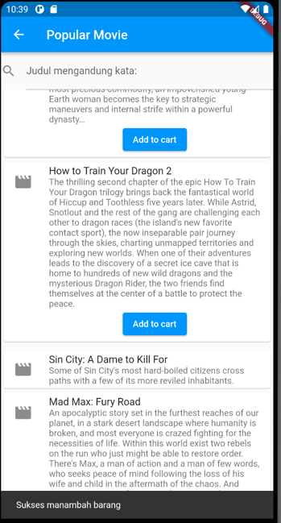
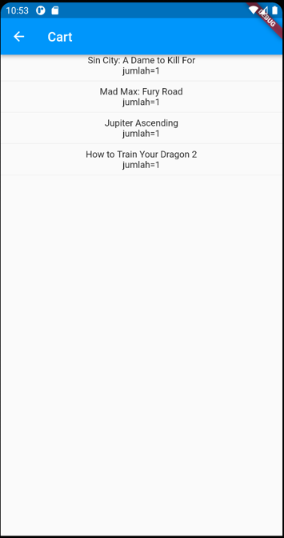
Test
Add some movies to cart, then view the cart

Slide 14
Increase Qty Button
Usually, on cart we can add/remove the item quantity by clicking + or – button. Prepare a function in the helper to add the quantity on a specified movie_id by 1. Add the + button for each item in the cart
Row(
children: [
Text('jumlah=' + _rsCart?[index]['jumlah']),
ElevatedButton(
onPressed: () {
dbHelper
.tambahJumlah(_rsCart?[index]['movie_id'])
.then((value) => _bacaData());
},
child: Text("+"))
],
),
Future tambahJumlah(movie_id) async {
Database? db = await instance.database;
await db?.execute('''
UPDATE cart SET jumlah=jumlah+1
WHERE movie_id=${movie_id}
''');
}

Slide 15
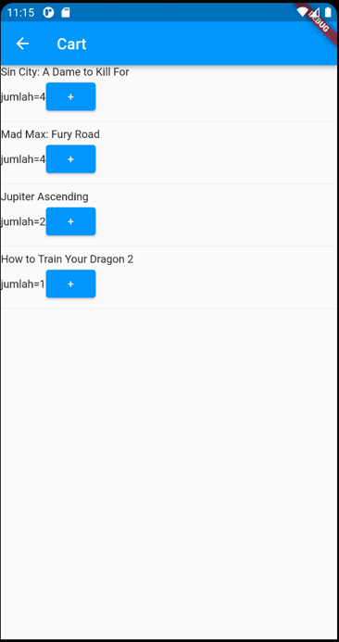
Test
Add some quantity to some movies.
Restart the app (or navigate back to this page) to prove that the data is stored on the local database
Can you implement the - button?

Slide 16
CHECKOUT
03

Slide 17
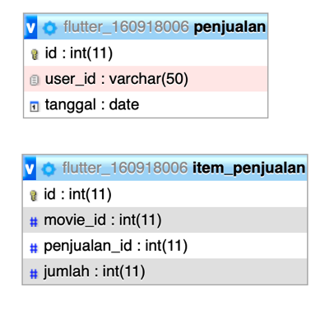
Sales and Sales Items
On the next step, user check outs the cart. Items on their cart will be stored on the server database, and cart will be emptied.
A sale transaction usually consists of a header and detail of transaction. Modify the database so the header will be stored in “penjualan” table, and transaction detail to “item_penjualan” table. Usually, they relate to the same key, e.g., transaction ID. To simplify, the transaction ID is auto-incremented, which will be returned when the header is successfully stored. The same ID will be used to insert the transaction detail.

Slide 18
Web Service
To simplify the data transfer to the server, we will construct a string like this:
movie_id_1,qty_1|movie_id_2,qty_2|movie_id_N,qty_N|etc.
The web service only requires user_id and items parameters. The items parameter will be split to data for each item, which will be split again to movie_id and qty

Slide 19
Web Service (2)
<?php
header("Access-Control-Allow-Origin: *");
. . . . Connection here . . . .
if (!isset($_POST['user_id']) || !isset($_POST['items'])) {
echo json_encode(["result"=>"error","message"=>"Missing parameters"]);
exit;
}
extract($_POST);
$sql = "INSERT INTO penjualan(user_id,tanggal) VALUES (?,now())";
$stmt = $conn->prepare($sql);
if (!$stmt) {
echo json_encode(["result" => "error", "message" => "Prepare failed: " . $conn->error]);
exit;
}
$stmt->bind_param("s", $user_id);
if (!$stmt->execute()) {
echo json_encode(["result" => "error", "message" => "Execute failed: " . $stmt->error]);
exit;
}
$penjualan_id = $conn->insert_id;
$arr_item = explode("|", $items);
foreach ($arr_item as $item) {
$arrdata = explode(",", $item);
if (count($arrdata) != 2) continue;
$sql = "INSERT INTO item_penjualan(penjualan_id,movie_id,jumlah) VALUES (?,?,?)";
$stmt = $conn->prepare($sql);
if (!$stmt) continue;
$stmt->bind_param("iii", $penjualan_id, $arrdata[0], $arrdata[1]);
$stmt->execute();
}
$arr = ["result"=>"success","message"=>"Data penjualan berhasil ditambahkan"];
echo json_encode($arr);
?>
Check it first using Postman or Thunder Client

Slide 20
Submit
void _submit() async {
_rsCart = await dbHelper.viewCart();
String items = "";
_rsCart?.forEach((item) {
items = items +
item['movie_id'].toString() +
',' +
item['jumlah'].toString() +
"|";
});
final response = await http.post(
Uri.parse("https://ubaya.cloud/flutter/[NRP]/checkout.php"),
body: {'user_id': activeUser, 'items': items});
if (response.statusCode == 200) {
Map json = jsonDecode(response.body);
if (json['result'] == 'success') {
ScaffoldMessenger.of(context)
.showSnackBar(SnackBar(content: Text('Sukses Checkout')));
}
}
}

Slide 21
Submit (2)
Add a Submit button below the Container. Wrap the Container with a Column, decrease its height, then add a Submit button below it. Call the submit() function when the button is clicked. If the check out is successful, call the empty cart function (after the snackbar)
appBar: ….,
body: ….,
bottomNavigationBar: Padding(
padding: const EdgeInsets.all(16),
child: ElevatedButton(
onPressed: _submit,
child: const Text("Checkout"),
),
),

Slide 22
Submit (2)
Add a Submit button below the Container. Wrap the Container with a Column, decrease its height, then add a Submit button below it. Call the submit() function when the button is clicked. If the check out is successful, call the empty cart function (after the snackbar)
Future emptyCart() async {
Database? db = await instance.database;
await db?.execute('''
DELETE FROM cart
''');
}
dbHelper.emptyCart().then((value) => _bacaData());

Slide 23



